Slide 2
Orgnisational Training
OT :-
Scope
Identification of Training needs
Preparation of Strategic and Tactical Training Plan
Identification of Internal and External Trainers
Scheduling the Training
Conduction of Training
Maintenance of Training Records
Analysis of Training feedbacks
Maintaining the Talent map for skill inventory
The Purpose of Organizational Training is to support the Organization’s Business Objectives and to meet the tactical training needs that are common across projects and support groups in the organization.

Slide 3
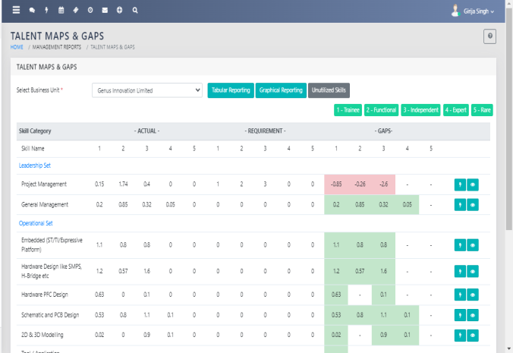
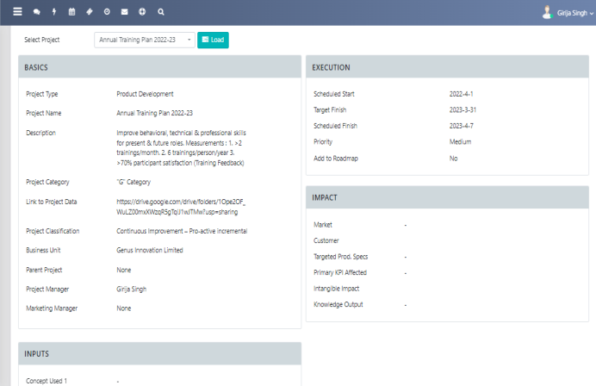
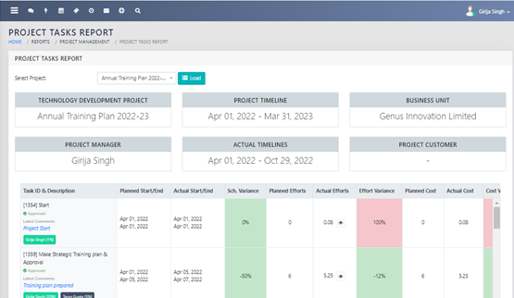
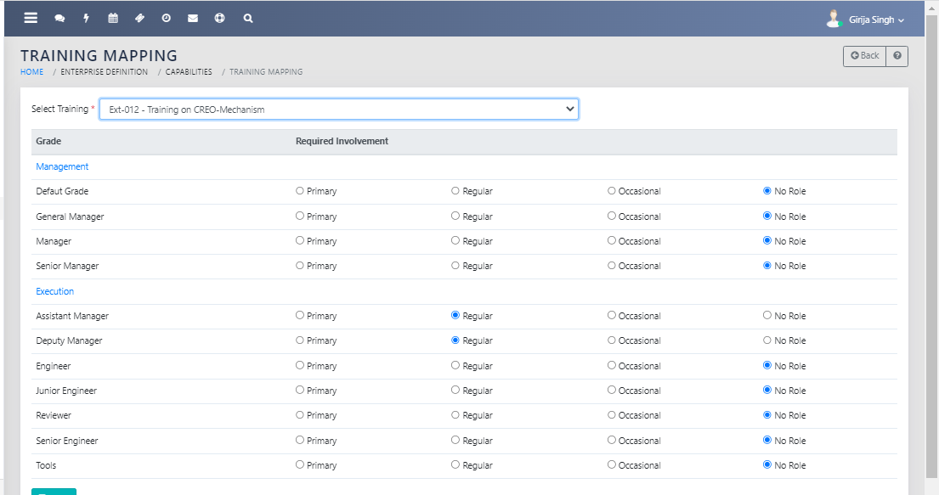
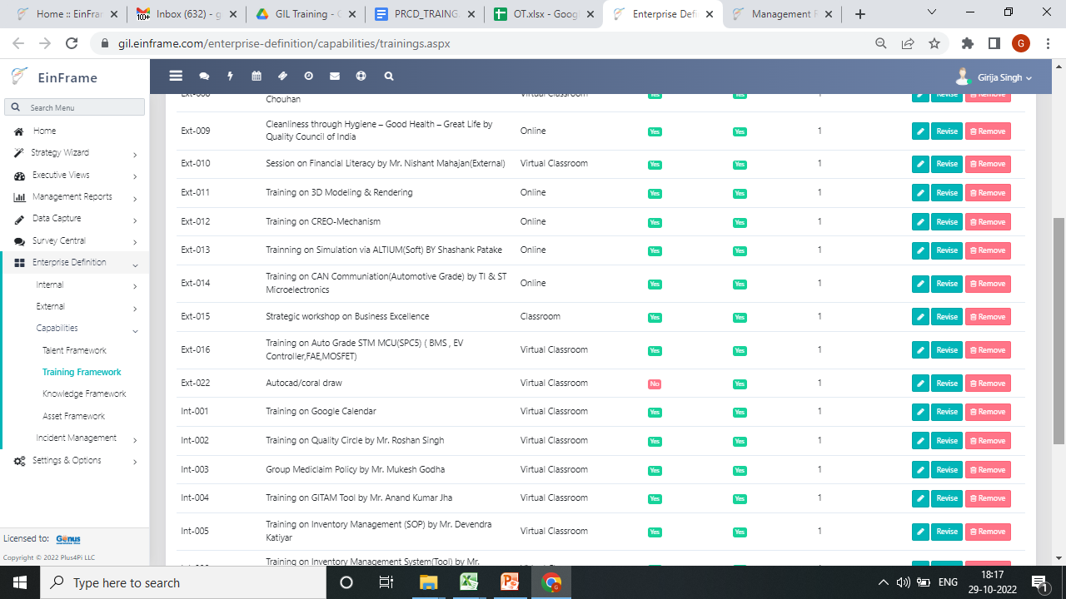
Identified Training Needs
Project Overview
Project Task
Training mapping
Preparation of Strategic and Tactical Training yearly Plan

Slide 4
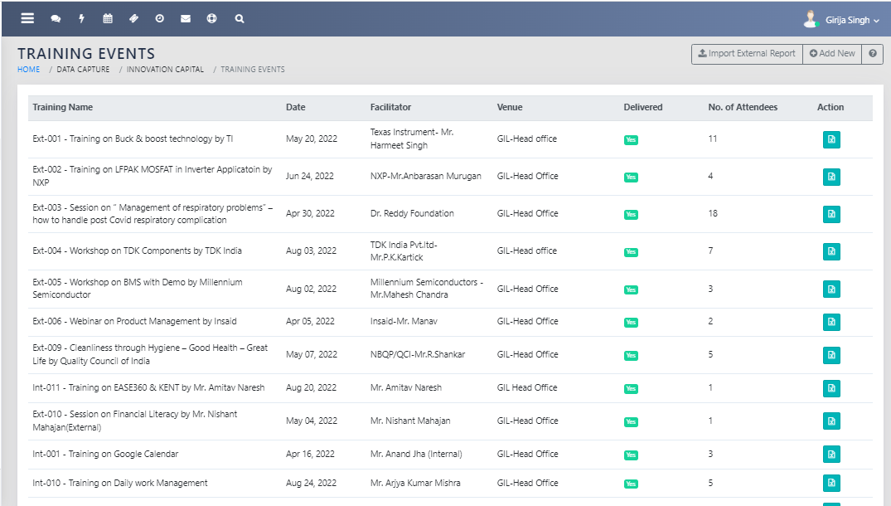
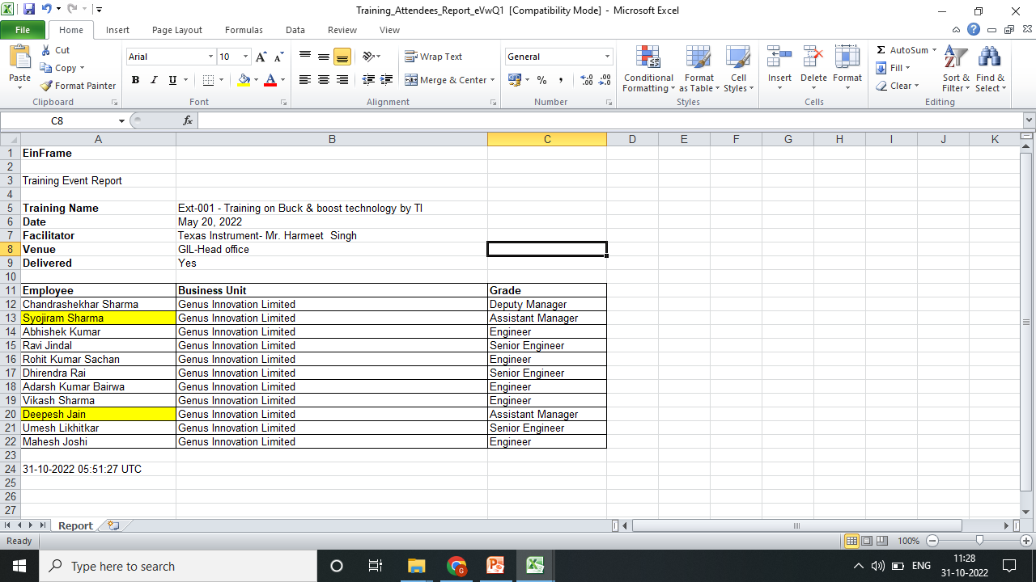
Organise training Event
Attendance Sheet
G-form:-Feedback Response Sheet
Timestamp | Email Address | Training Name | Employee Name | Employee Code | Designation | Training Manhours | Contents | Could the facilitator generate interaction | Facilitators Knowledge on the subject | Quality of course material | The Content relevance | Quality of presentation | Average (Individual) | Strength of the program | Areas of improvement of the program | Learning | Trainer/Fasilitator Name | Name/Employee Code | TRG ID
5/20/2022 18:02:37 | syoji.sharma@genusinnovation.com | Ext-001 Training on Buck & boost technology by TI | syoji | 15008 | assistant Manager | 2 | 2 | 4 | 8 | 8 | 7 | 8 | 6 | KNOWLEGE UPGRADE | COMPONENT SELECTION OF BUCK AND BOOST | DESINING CONCEPT OF BUCK AND BOOST UPDATED | Ti team |  | INT
5/20/2022 9:23:25 | deepesh.jain@genusinnovation.com | Ext-001 Training on Buck & boost technology by TI | deepesh jain | 14191 | Dy. Manager | 2 | 4 | 4 | 9 | 9 | 9 | 9 | 7 | NEW upcoming part knowledge | It was Ok | new part | TI employee |  | EXT, INT

Slide 5
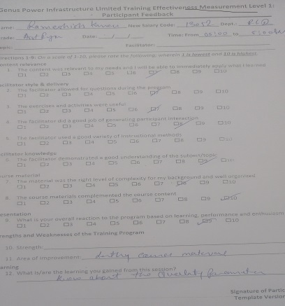
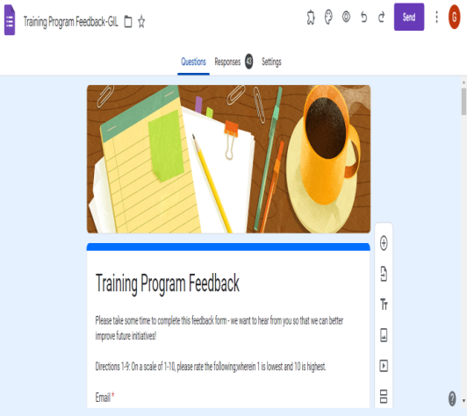
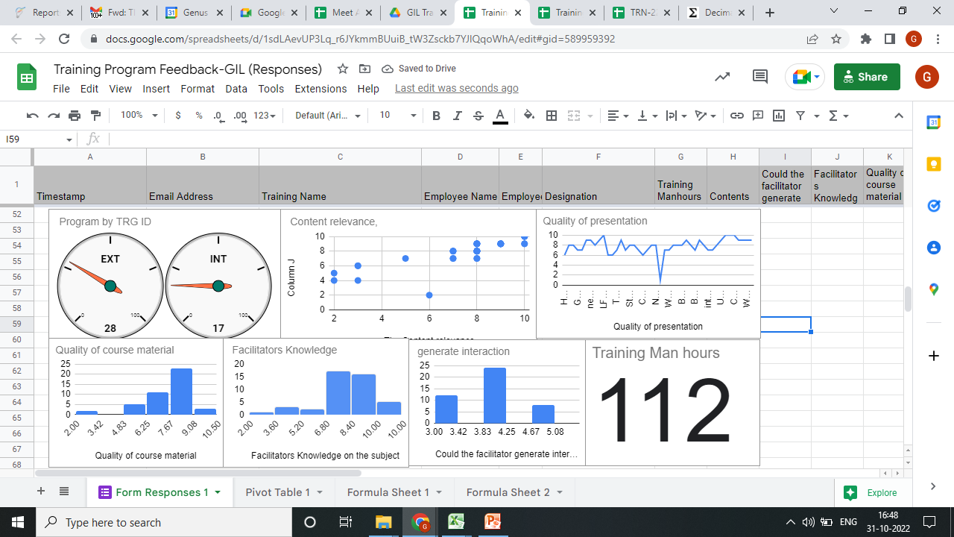
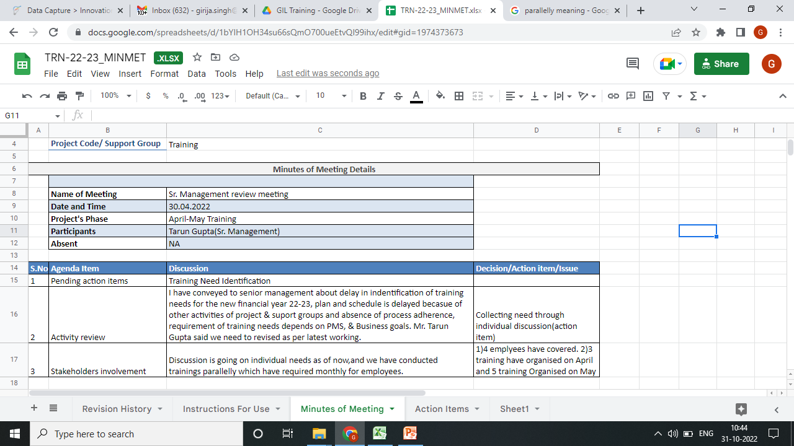
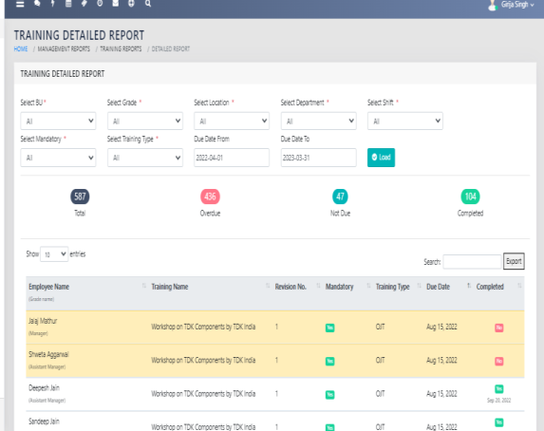
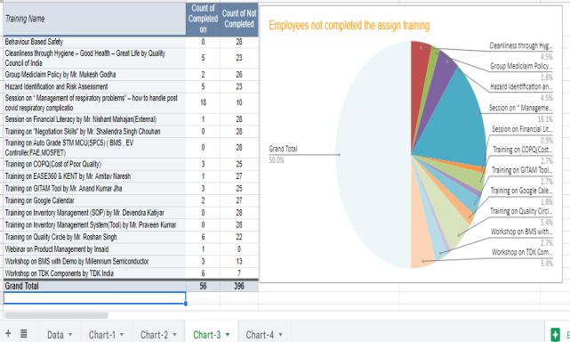
Training Detail Report
Earlier collected the feedback in hardcopy but after PQA evaluation we have design google form
Maintain Training Records and Analyse Feedbacks
Google Drive:- Video recording, ppt etc.
Monthly meeting
Training Detail Report
Analysis of Training Data

